Slide 1

CredentialChain
Blockchain-Based Academic Credential System with Verifiable Credentials
Cecil Baraik
B.Sc. Information Technology · Batch 2025 · Amity University Jharkhand
Notes:
Good morning. My project is CredentialChain, a blockchain-based system that lets colleges issue digital certificates that anyone can verify in seconds.

Slide 2




The problem: fake certificates
Easy to forge
Slow to verify
Insider risk
No independent proof
Paper and PDF certificates can be edited with ordinary software in minutes.
Employers email or phone the college and wait days for an answer.
A staff member can quietly change a grade in a central database.
Students cannot share a certificate that anyone can check on their own.
Goal: make any certificate verifiable in seconds — and impossible to change without being caught.
Notes:
Fake certificates are common. Verifying them is slow, and even the college database can be changed by an insider. Our goal is instant, tamper-evident verification.

Slide 3


The solution in one line
Store a fingerprint of every certificate on a blockchain that cannot be changed — and compare fingerprints to verify.
College
Student
Employer
Issues and signs certificates, can revoke them
Gets a PDF with a QR code and a signed file
Scans the QR code — answer in seconds, no login
Notes:
The idea: the college stores a SHA-256 fingerprint of each certificate on a blockchain. To verify, we recompute the fingerprint and compare. Three people use the system: college, student and employer.

Slide 4
How a certificate is issued
1
2
3
4
5
Fill the form
SHA-256 hash
ECDSA signature
Pending pool
Mine a block
Student name, roll no., program, grade
Unique 64-character fingerprint
Signed with the college's private key
ISSUE transaction holds only the hash
Proof-of-work: hash must start with 0000
Privacy by design: the full record stays in the database — only the fingerprint goes on the blockchain.
Notes:
Five steps. The key point: only the hash goes on the chain, so no personal data is ever published.

Slide 5
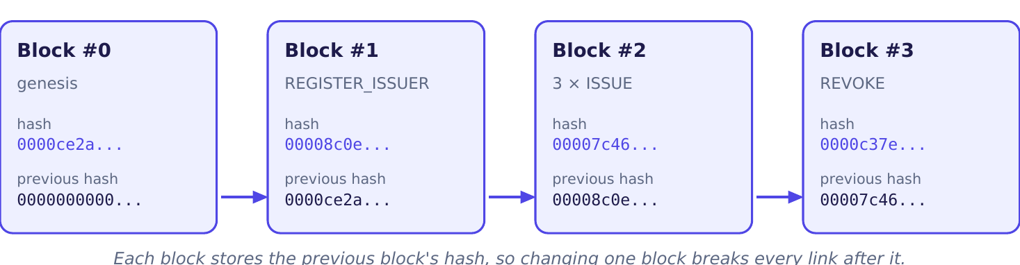
Inside the blockchain
Hash link
Merkle root
Nonce
Genesis
Every block stores the previous block's hash
One hash that represents all transactions
Number the miner changes until the hash starts with 0000
Block #0 — the start of every chain
Notes:
Each block is linked to the one before by its hash. If anyone changes an old block, its hash changes and every link after it breaks.

Slide 6




Cryptography that makes it trustworthy
SHA-256
ECDSA P-256
Change one character → a completely different fingerprint
Private key signs; anyone checks with the public key
Proof-of-work
Merkle tree
Rewriting history means redoing the mining work
Any edited transaction changes the block’s root hash
Notes:
Four building blocks: SHA-256 for fingerprints, ECDSA signatures to prove which college issued it, proof-of-work and Merkle trees to protect the chain.

Slide 7

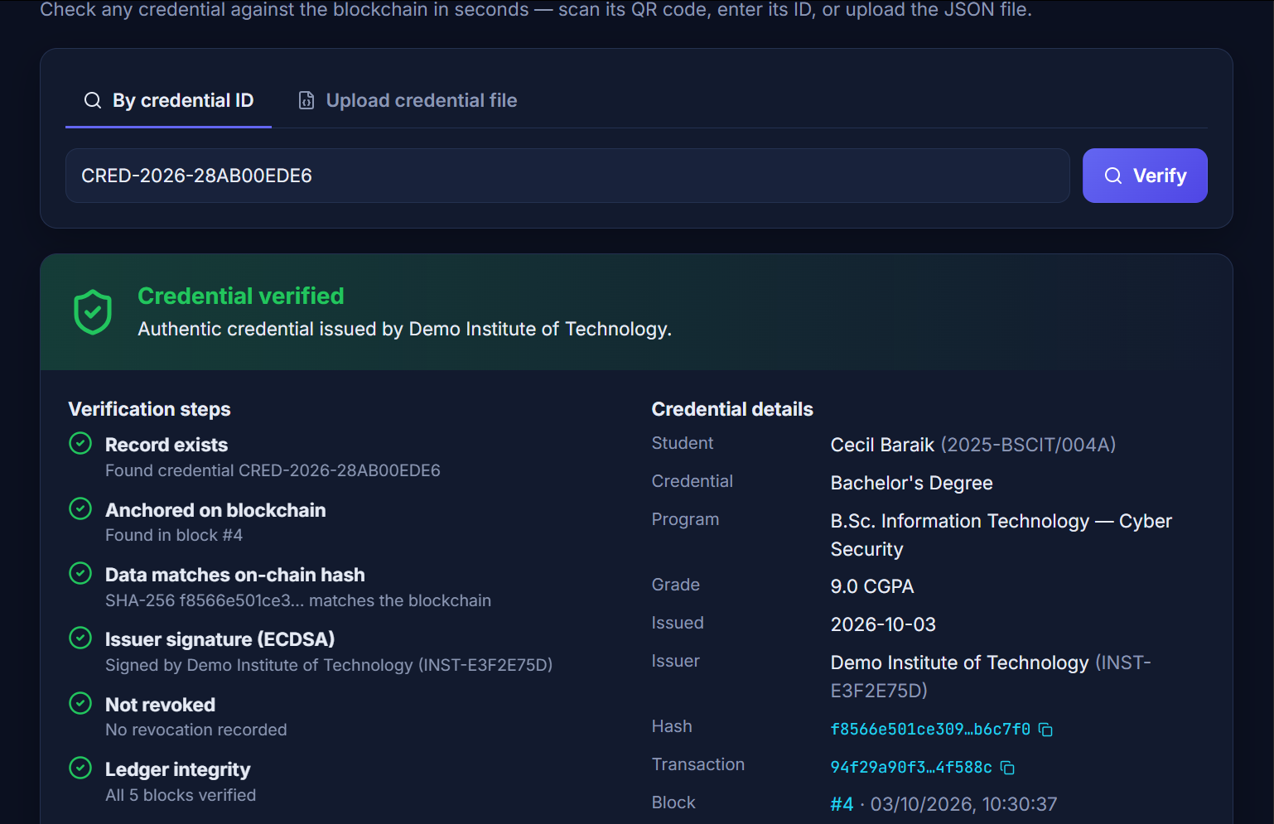
Six checks on every verification
1. Record exists
2. Anchored on the blockchain
3. Data matches the on-chain hash
4. Issuer signature is valid
5. Not revoked
6. Whole ledger is intact
VALID
PENDING
REVOKED
INVALID
Notes:
Verification runs six independent checks. All six must pass for VALID. The result can also be PENDING, REVOKED or INVALID.

Slide 8
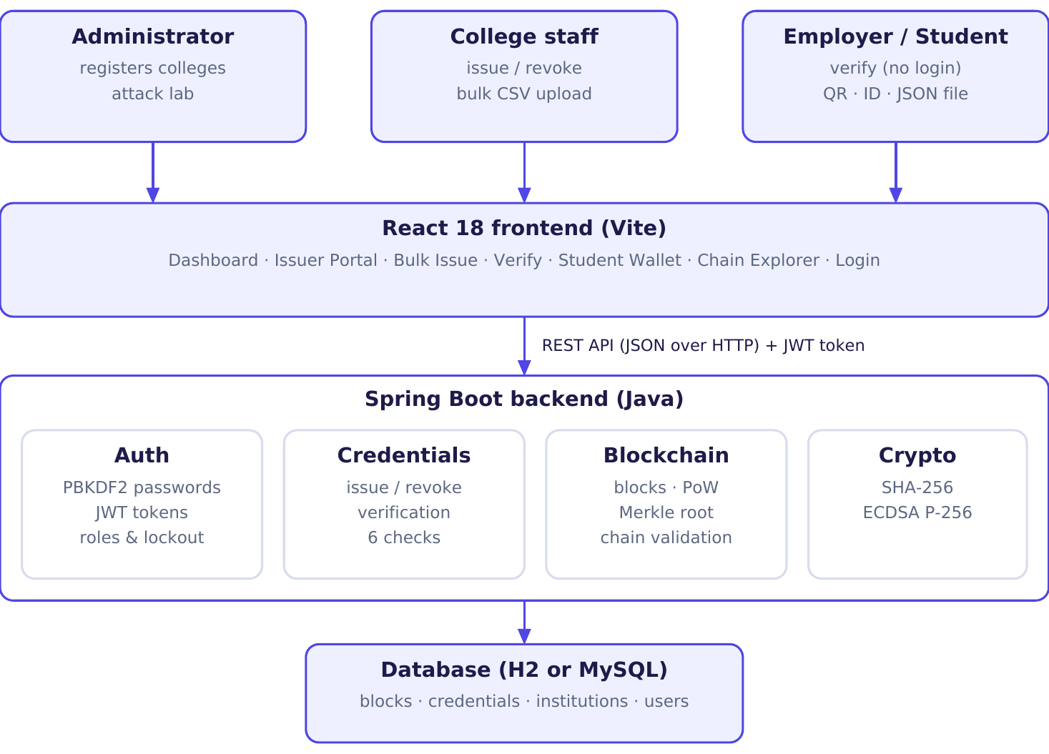
System architecture
Frontend
React 18 + Vite
Backend
Java · Spring Boot 3
Database
H2 or MySQL 8
PDF & QR
jsPDF · qrcode
Testing
JUnit 5 · MockMvc
Notes:
Three tiers: a React frontend, a Spring Boot REST API with auth, credential, blockchain and crypto modules, and an H2 or MySQL database.

Slide 9





Key features
Verify 3 ways
PDF certificates
Bulk CSV issue
Credential ID, QR scan or signed JSON file
Printable, with QR code and REVOKED stamp
A whole class at once, every row checked
Revocation
Live dashboard
Works on phones
Cancel with a reason; history is kept
Charts for blocks, status and mining effort
Open over Wi-Fi or a free public tunnel
Notes:
Beyond issue and verify: PDF certificates with QR codes, bulk upload from Excel, revocation, a live dashboard, and phone access.

Slide 10

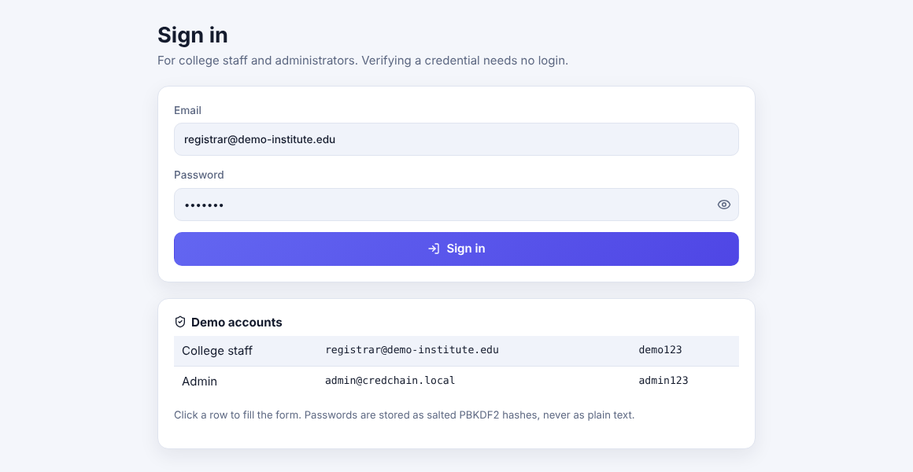
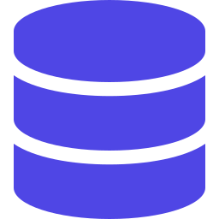
Security of the application
PBKDF2 password hashing
Random salt, 210,000 iterations — no plain-text passwords
Signed JWT login tokens
Editing the role inside the token breaks its signature
Role-based access
Admin registers colleges · staff issue · anyone verifies
Brute-force lockout
5 wrong passwords → locked 5 minutes, same error message
Least-privilege database user
App user can only touch the credchain database
Notes:
Login is protected with salted PBKDF2 hashes, signed JWT tokens, roles and lockout. The MySQL user can only access its own database.

Slide 11
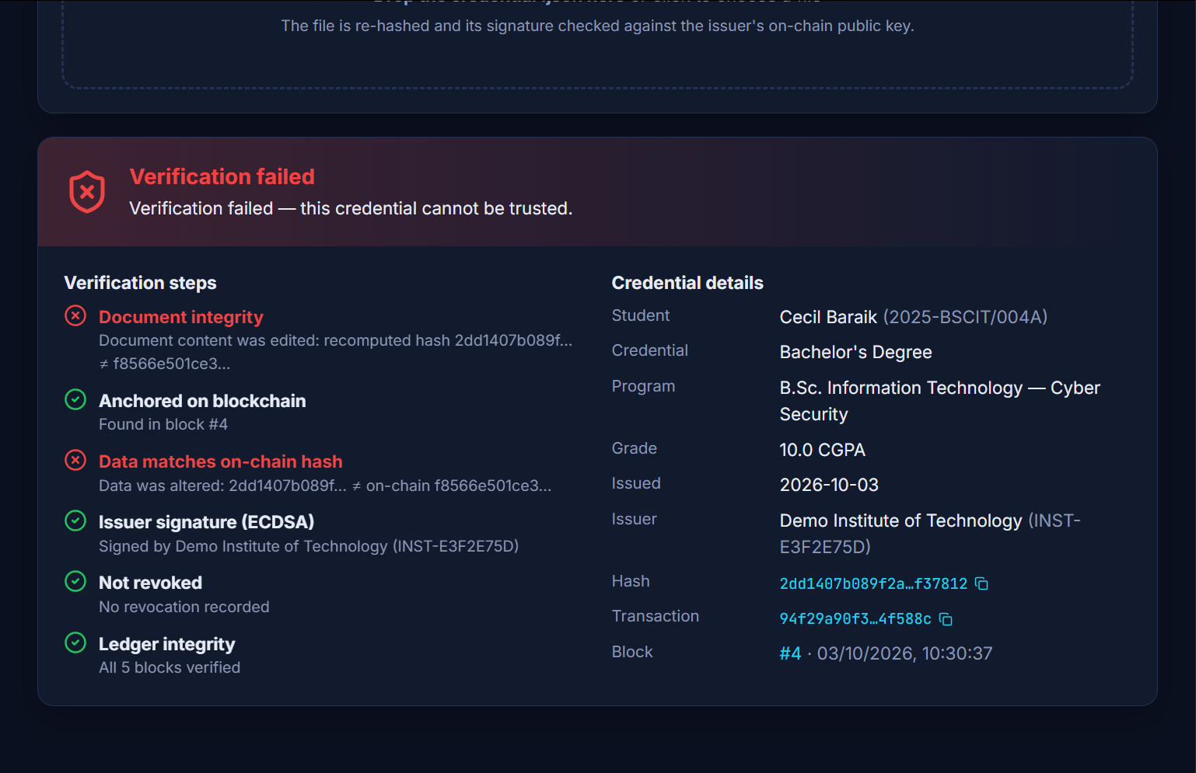
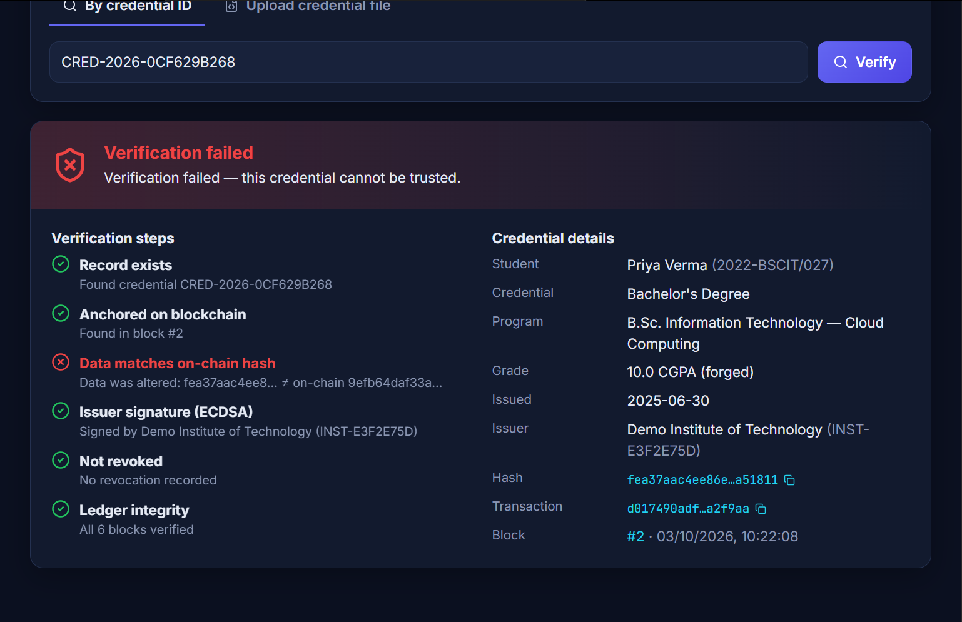
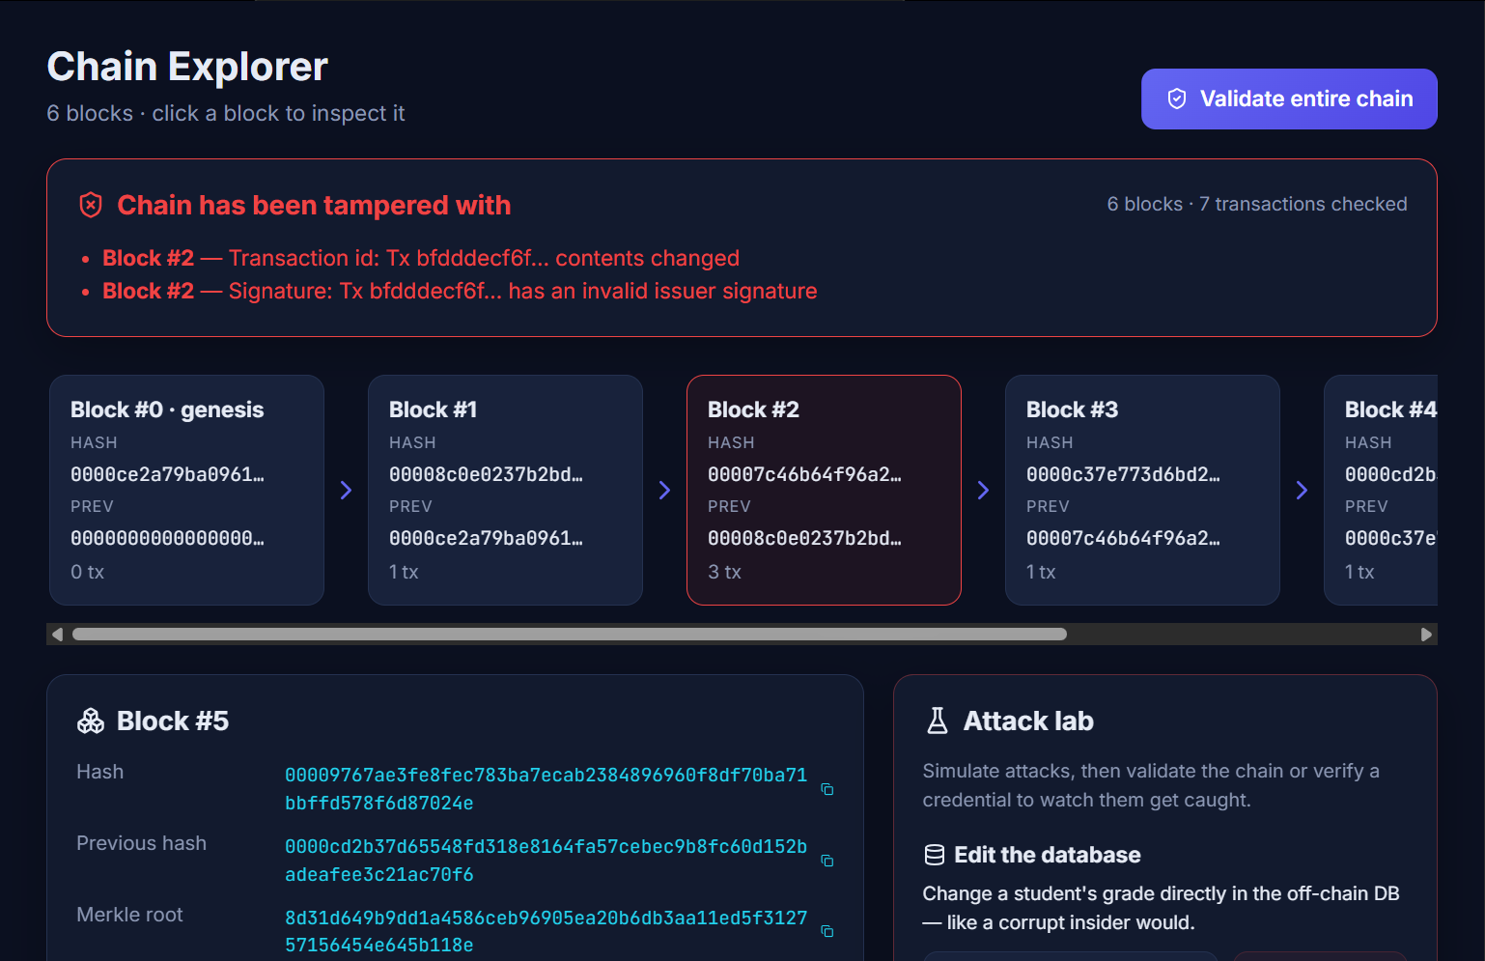

Attack tests: every tampering is caught
Edited downloaded file
Insider edits database
Hacker edits a block
Grade 9.0 → 10.0: hash and signature mismatch
Record no longer matches its on-chain hash
Chain validation flags the block in red
“Restore everything” brings the chain back to valid — proving the checks, not luck, caught the attacks.
Notes:
I attacked my own system three ways: editing the downloaded file, editing the database, and editing a mined block. All three were detected.

Slide 12
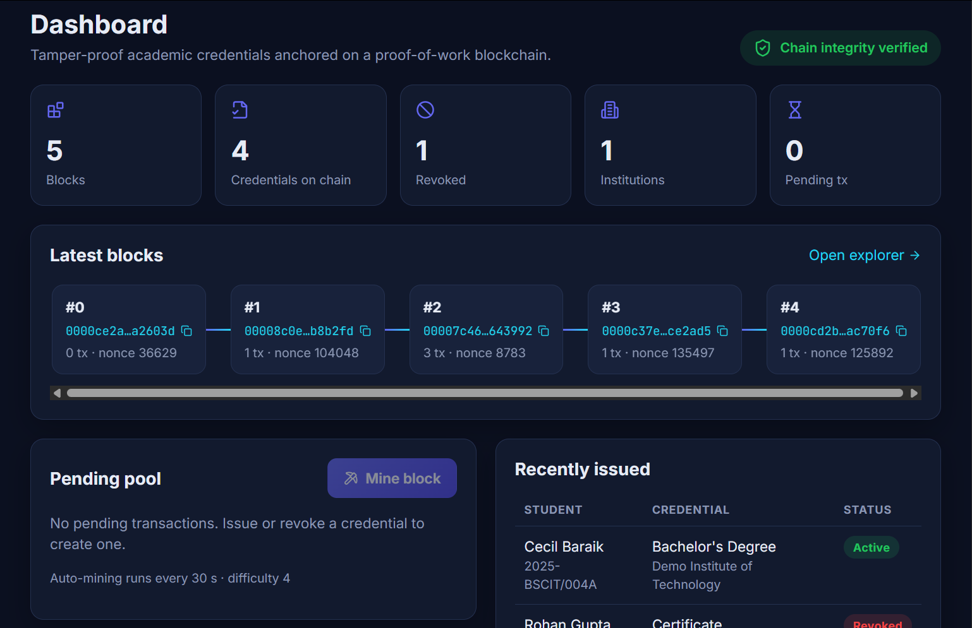
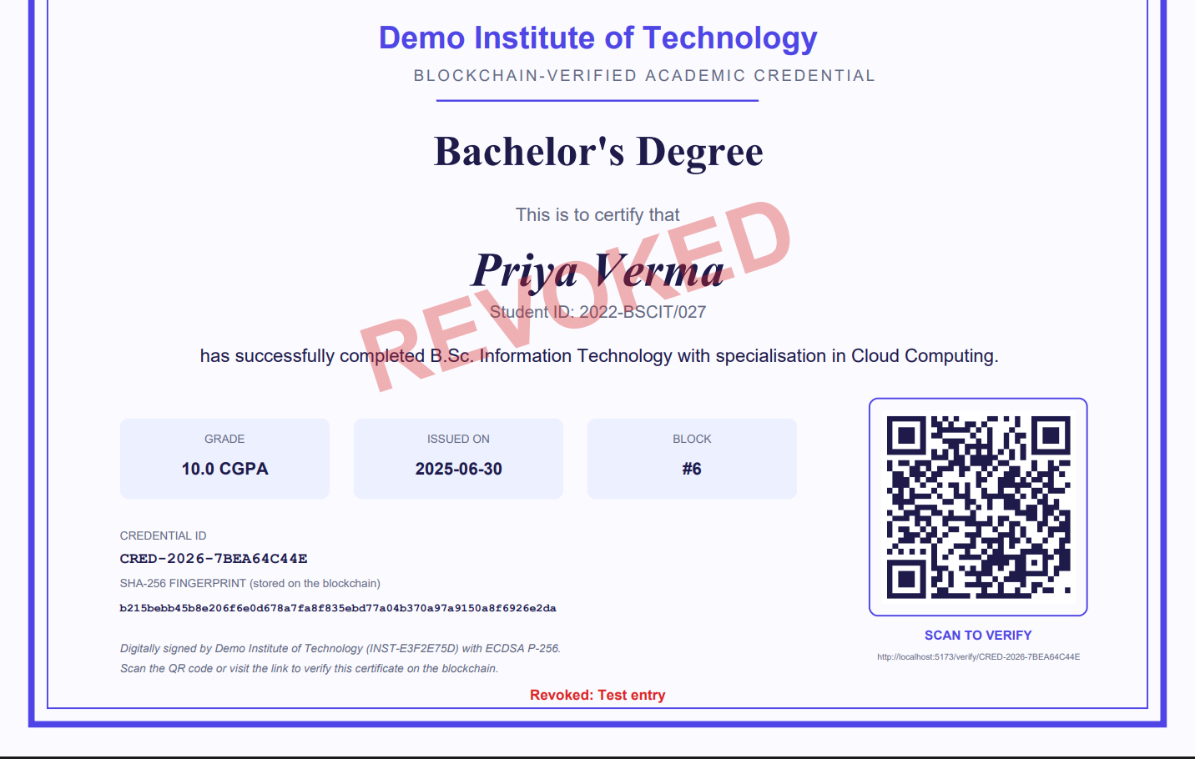
The application
Dashboard: blocks, stats and pending pool
PDF certificate with QR code (revoked example)
Notes:
Here is the dashboard and a PDF certificate. Now I will show a short live demo.

Slide 13
Testing results
20
44
3/3
6
test cases passed
automated logic checks
attacks detected
checks per verification
Unit tests — SHA-256, ECDSA, mining, Merkle root, tamper detection
Integration test — login → issue → mine → verify → forge → tamper → restore → revoke
Manual browser tests of every page, on H2 and MySQL
Notes:
All twenty test cases passed, including the security tests for roles, lockout and forged tokens.

Slide 14
Limitations and future scope
Limitations today
Future scope
Single node — tamper-evident, not yet decentralised
College private keys kept on the server for the demo
QR works on phones only when the app is reachable
Multi-node consensus, or Ethereum / Hyperledger Fabric
Colleges sign with their own hardware wallet
W3C Decentralized Identifiers (DIDs)
Two-factor login and email delivery to students
Notes:
Honest limitations: it is a single node and keys are server-side for the demo. Next steps are multiple nodes and real wallets.

Slide 15
Thank you
Fake certificates are caught in seconds — because a fingerprint on the blockchain cannot lie.
Questions?
Cecil Baraik · github.com/cecilbaraik19
Notes:
To conclude: CredentialChain makes certificates verifiable in seconds and tamper-evident. Thank you, I am happy to take questions.

